Slide 1
How to use this deck
Use the following slides to design and lead your own Theory of Change workshop with your team.
A workshop that follow this flow usually takes approx 2 hours.
You’ll need real or virtual post-it notes and a board / space to work with them.
The accompanying pre-read for this is workshop is the Centre’s Design & Define workbook (link)
Each slide includes talking points in the notes field.
Customise the slides as needed. Add in work you’ve done already on Theory of Change to set the starting
point, add your organisation’s branding, revise the slide text or the talking points, or insert new slides.
Notes:
If you are facilitating this workshop, you should
be confident in your understanding of the key principles and purpose of a ToC
know what work your organisation has done previously regarding mapping out a ToC and include that as the starting point
Be clear on wether this workshop is looking at ToC at the organisational level or at the programme level
have facilitation skills and experience in order to allow healthy, productive and inclusive debate and discussion

Slide 2
Theory of Change workshop
Notes:
Welcome everyone.
Does everyone in the room know each other? Do you need to do a round of intros?
Housekeeping
Share the aim of the workshop
a theory of change sets out why we do what we do and what exactly it is that we do - we’re going to talk about the context for our work and the ways in which we think our organisation / XXXXXX program creates positive change for young people.
Getting clearer about what we know and what we don’t know about how we create change through this process will lead us to build and even better, stronger and high quality practice of youth provision
Review work done previously (as appropriate)

Slide 3
Which cat best describes how you are feeling today?
1
2
3
4
5
6
7
8
Notes:
Landing ‘in the room’
- How is everyone feeling? Start with an icebreaker of some kind, or a even a quick grounding meditation (you can find lots of recordings online) so people can shake off their day to day tasks and focus on the session
Question about the workshop round robin
- ask everyone to share any thoughts or questions or concerns about today’s workshop.

Slide 4
What can I expect from today’s workshop?
Context setting and understanding the key components of ToC | 20 minutes
Mapping out our aim(s), outcomes and mechanisms of change | 25-35 minutes
Debating the flow and arranging these ideas into a coherent ToC | 45-60 minutes
- Formalising into a ToC diagram - Putting this out for consultation with people who aren’t here today, and other stakeholders - Finalising our ToC | After the workshop
Notes:
We’re not going to ‘finish’ our Theory of Change work today - it’s a process - a ToC has never been completed in a single workshop - it’s a process. In this workshop we’ll be covering:
Context setting and understanding key components
Mapping out our key components
Debating the flow and how these logically fit together
After this, we’ll be taking it to other teams and colleagues and stakeholders for comment and builds.

Slide 5
An introduction to theory of change principles
Notes:
The main aim of a ToC to make sense of the work that we do. Why do the activities we deliver achieve the change we are aiming for?
What are your experiences of ToC?
(This would be a good place to review work that you’ve done on ToC before to set the right starting point as well as listen to general experience from around the group)

Slide 6
Activity
MAGIC
Aim
Work with young people
Improved well being
Notes:
We all work with young people in order to effect change in something – like wellbeing. And what happens between ‘working with young people’ and ‘improved wellbeing’ can sometimes feel a bit like ‘magic’. A Theory of Change helps to expose what’s in the black box - which is vital work, but definitely not ‘magic’.
Describing this process doesn’t undermine it at all. It might feel like working with young people is something that you can’t define when a change for a young person comes about organically, maybe slowly, and is experienced in different ways by different young people, but this can definitely be reflected in a theory of change if that is a deliberate way of working with young people. Thinking through a theory of change means looking at what we do and being confident that it’s intentional and everything we do is focussed towards having impact.

Slide 7
Asking Good Questions
Why do you do what you do?
Are you achieving your aims?
What exactly are you doing?
What do young people think about what you do?
Are you doing it consistently well?
Are you staying true to your premises?
Notes:
Open us discussion via asking for reflections from the pre-reading (Design and Define workbook)

Slide 8
Discussing and developing our Theory of Change:
Creates time and space for reflection, outside our busy day to day
Consolidates what we already know
Uncovers assumptions we might be making, and new questions to explore
Explains why we do what we do for stakeholders (e.g., funders) – a good opportunity for them to listen deeply
Explains exactly what we do, and helps guide design of new projects and programmes
Provides a framework for an evaluation plan

Slide 9
ToC Core Components & Language
Notes:
We’re going to run through the key terminology so we’re all on the same page for the discussions ahead.

Slide 10
Core components of a Theory of Change:
Aim – The thing that gets you up in the morning; the impact that individuals (young people) and communities achieve for themselves
Outcomes - the knowledge, skills and assets that your provision develops amongst young people and communities (and for which you are held accountable), that in turn enable them to achieve impact for themselves
Mechanisms of change- the process through which young people engage and benefit; what young people experience ‘in the moment’ that creates or affects change. Where you can be explicit about assumptions and context; and reinforce what high quality looks and feels like
Activities: what you do, with whom and in what context, again defines high quality
Notes:
You may include an additional element: Outputs - the amount of something you deliver; ‘things’ produced. Not all theories of change include outputs – how important they are to you will determine whether they are there or not. (Frequency and duration of sessions should be included as part of activities)
Many theories of change also include an ’accountability line’ which marks the point at which it would be expected that a young person disengage or ‘graduate’ from a project – this is usually before the long term impact and it’s an acknowledgement of the decrease of control that a programme has over outcomes when the young person isn’t actively engaged in an activity – you’ll see examples of this later.
Discussions/Questions on this slide could be:
Outcomes - do we need them?
- Without them it’s hard to be genuinely intentional, what are you working towards? Is everyone on your team working towards the same thing?
Outcomes should always include a word to do with measurement (e.g. more, greater).
People sometimes try to attach outcomes to short-term interactions
- improved attendance is not an outcome, but it could be important for achieving outcomes
People will often attach hard aims/activities/outcomes sometimes based on fleeting interactions
example
Note that funders might be looking for specific outcomes

Slide 11
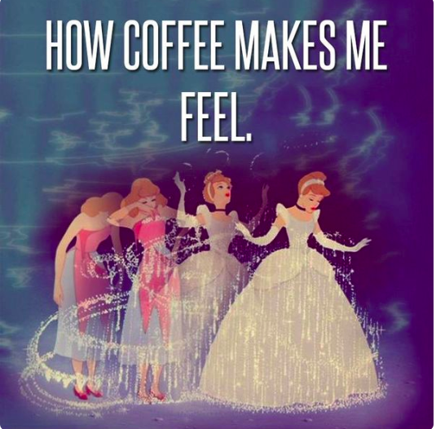
More on Mechanisms of Change
Mechanisms of change are a core component of a ToC. They are influential factors that will help or hinder young people to experience outcomes, so it’s important to make sure they’re in place and you know what they are.
Would coffee have this same effect without caffeine?
When you’re writing your theory of change, be explicit about what has to happen in order for young people to experience a change.
Notes:
Just like the caffeine in coffee, one way to think about mechanisms of change is as ‘active ingredients’. What is it specifically about your program that brings about change?
Understanding what our Mechanisms of Change are is the difference between high quality and not high quality offer or program: what’s the caffeine?
Do we know? If the group is not clear on this, then you could ask questions about mechanisms of change that are typical when working with young people like:
trust - ‘how important is it that young people feel able to trust you? What happens if they don’t?’
respect
Safe space
Challenged

Slide 12
Other elements of a theory of change:
Need: Is there a particular problem or deficit that you aim to address? If so, it is helpful to have that on your theory of change
Outputs: the amount of something that you deliver; the ‘things’ produced. How important they are to you will determine whether they should be on your theory of change or not.
Accountability Line: defines a project’s sphere of influence; marks the point at which a project has less control over outcomes leading towards the aim
Notes:
Outputs are the amount of something we deliver; ‘things’ produced. Not all theories of change include outputs – how important they are to us will determine whether we include them or not. An example of an output would be a young person making a particular artefact or gaining a qualification or their attendance on a program improving. Outputs are like stepping stones on the way to an outcome.
Many theories of change also include an ’accountability line’ which marks the point at which it would be expected that a young person disengage or ‘graduate’ from a project – this is usually before the long term impact and it’s an acknowledgement of the decrease of control that a programme has over outcomes when the young person isn’t actively engaged in an activity – we’ll look at this more closely later on.
Need - understanding our context is an important exercise to ensure that young people need AND want what we’re are offering. Context and need are really the backdrop to our work (so thinking on this should occur before designing a detailed ToC - if you don’t feel you have looking at this closely enough, then that’s a task to pick up as part of your ToC activities).

Slide 13
This… So that - chain
Activity 1
Mechanism of change
Activity 2
Mechanism of change
So that
Outcome 1
Outcome 2
Aim
Notes:
To develop a coherent theory of change, it can be helpful to look at this chain - ‘that is...so that…’ - which helps us think about causal links.
For example,
This…
Activity:
Young people create and lead social action in projects in teams and work with community members and programme staff to complete them
Mechanism:
Community groups are engaged with the service and work with young people
Young people feel heard and respected
So that…
Outcomes:
Young people gain a greater understanding of local issues and knowledge of community actors and there is increased participation and voice of young people in community issues/organisations

Slide 14
Weekly 121 mentoring to improve young people’s self-esteem
Notes:
We’re going to play a quick game to test your knowledge and understanding of these core components:
(On each slide there is an animation that will show the correct answer on your click, so move to the slide, ask the group for their answers and then click to show the right answer)

Slide 15
It is an Activity, Output, Mechanism of Change, or Outcome?
Activity
Weekly 121 mentoring sessions
Output
Mechanism of change
Outcome

Slide 16
It is an Activity, Output, Mechanism of Change, or Outcome?
Activity
Quality of relationship between mentor and mentee
Output
Mechanism of change
Outcome

Slide 17
It is an Activity, Output, Mechanism of Change, or Outcome?
Activity
Improved self-esteem
Mechanism of change
Outcome

Slide 18
It is an Activity, Output, Mechanism of Change, or Outcome?
Weekly 121 mentoring
Activity
Quality of relationship between mentor and mentee
Mechanism of change
Improved self-esteem
Outcome

Slide 19
A local pottery studio hosts family days where parents and children make cups together.

Slide 20
It is an Activity, Output, Mechanism of Change, or Outcome?
Activity
Cups produced during the workshop
Output
Mechanism of change
Outcome

Slide 21
It is an Activity, Output, Mechanism of Change, or Outcome?
Activity
Pottery workshop with families
Outputs
Mechanism of change
Outcome

Slide 22
It is an Activity, Output, Mechanism of Change, or Outcome?
Activity
Parents are engaged and encourage their children during the workshop
Output
Mechanism of change
Outcome

Slide 23
It is an Activity, Output, Mechanism of Change, or Outcome?
Pottery workshops with families
Activity
Mechanism of change
Parents are engaged and encourage their children during the workshop
Cups produced during the workshop
Output
?
Outcome
Notes:
What could potential outcomes be?
How might this activity create positive change for young people in terms of their relationships with their parents by undertaking an activity together? And to their confidence at having created something creative in the workshop? (clues to outcomes in these questions…)

Slide 24
A local housing association is establishing a youth club on an estate so that young people engage more positively with the community.

Slide 25
It is an Activity, Output, Mechanism of Change, or Outcome?
Activity
Open access youth club on a housing estate
Outputs
Mechanism of change
Outcome

Slide 26
It is an Activity, Output, Mechanism of Change, or Outcome?
Activity
Young people feel included and a sense of connection with their community
Output
Mechanism of change
Outcome
Notes:
Why isn’t this an outcome?
- If you had evidence that young people felt excluded or a lack of connection with their community, this might be an outcome, but that’s not the stated outcome in this particular scenario

Slide 27
It is an Activity, Output, Mechanism of Change, or Outcome?
Activity
Increased positive engagement within the community outside of the youth club
Output
Mechanism of change
Outcome
Notes:
Increased positive engagement - outcomes usually indicate a change to something

Slide 28
It is an Activity, Output, Mechanism of Change, or Outcome?
Open access youth club in a housing estate
Activity
Young people feel included and sense of connection with their community
Mechanism of change
Increased positive engagement within the community outside of the youth club
Outcome

Slide 29
The role of existing research
Activities
What has already been found to be effective in achieving your outcomes & aims?
Are you performing the right activities?
What challenges have similar programmes encountered?
What risks might you face?
Is there robust pre-existing evidence that these activities achieve your outcomes & aims? If so, you may not have to perform additional evaluations.
Mechanisms
Outcomes
Aim
Notes:
How much do we know about the evidence that supports the work we do?
The Centre for Youth Impact has a resource hub that contains a lot of current thinking and evidence about working with and for young people. Building your knowledge of the evidence that’s out there will help you design and deliver high quality offers and programmes.

Slide 30
Reviewing theory of change
A theory of change is a living document that evolves over time as you learn from evaluation
By reviewing and refining your theory of change, you will
Consolidate what you’ve learnt thus far
Increase the precision of the diagram
Align the final phase of your evaluation with your most current theory
Notes:
It’s important to review your ToC over time - this is not a ‘one-off’ conversation or process, but we should also be reflecting on our theory of change and refining it.

Slide 31
A good ToC should help you answer the following questions
What are the aims of your work? What does success look like?
Who will you work with? Are there any key criteria?
Why do you want to work with this group? What do you know about them?
How will your approach support your target group?
What changes does your organisation want to make in the sector? Is there a gap it’s aiming to fill?
What’s core to the programme design and what is flexible?
Notes:
A good ToC will help you to answer the following questions
It is NOT evidence of impact on it’s own!

Slide 32
BREAK

Slide 33
Mapping out our theory of change

Slide 34
The process
We’ll brainstorm aim(s), outcomes, mechanisms of change and activities in small groups
By writing an example of each of the above on a post and stick them to a wall or flip chart (or the virtual board)
Then as a group, we’ll discuss and debate the logical flow and move post-its around until we’re all happy with the sequence
After today we’ll transfer what’s on the post-its into a theory of change diagram. We find that PowerPoint works well. Templates are provided below.
We’ll take it to others in our team to consult with them and see if it makes sense to them.

Slide 35
Tips for writing activities
Activities on your theory of change should set out precisely what you are doing, with whom, how often, and in what setting.
When writing your activities, include the following details:
Approach: activity type and mode of delivery
Setting: where activities take place
Audience: who activities are intended for
Dosage: the frequency of activities and duration
It can also be useful to include information about who is delivering the activities

Slide 36
Tips for writing mechanisms of change
Mechanisms of change
Experiences and feelings that young people need to have to achieve outcomes.
What high quality work looks like and feels like for young people.
Environment & relationship
Young people trust and feel trusted (both initially & more deeply over time)
Young people feel respected
Young people don’t feel judged or punished
Young people feel safe & secure
Nature and delivery of activity
Young people feel positively challenged
Young people feel a sense of enjoyment (including fun & a deeper satisfaction)
Young people feel a sense of purpose, achievement & contribution
Community
Young people feel included & a greater sense of connection with their community
Young people feel empowered to create change in their lives and in the world around them
Taken from the Youth Investment Fund Grantee Theory of Change

Slide 37
Tips for writing outcomes
Use ‘change’ words when writing outcomes on your theory of change
Improved
Increased
Reduced
Decreased
Maintained
Outcomes should be specific and related to your activities

Slide 38
Notes:
Ok let’s start in our groups - put down as many ideas as you can about examples of activities, mechanisms of change, outcomes, and aims(s) are.
Use different colours per component.
We can include need and outputs if we think these are important too.
This is a good point to remind the group if you’re looking at the organisation as a whole, or just one programme.
Be specific, but don’t overthink! The more ideas the better at this stage, we can then discuss and refine.
Use Asking Good Questions worksheets to prompt thinking
30 minutes.

Slide 39
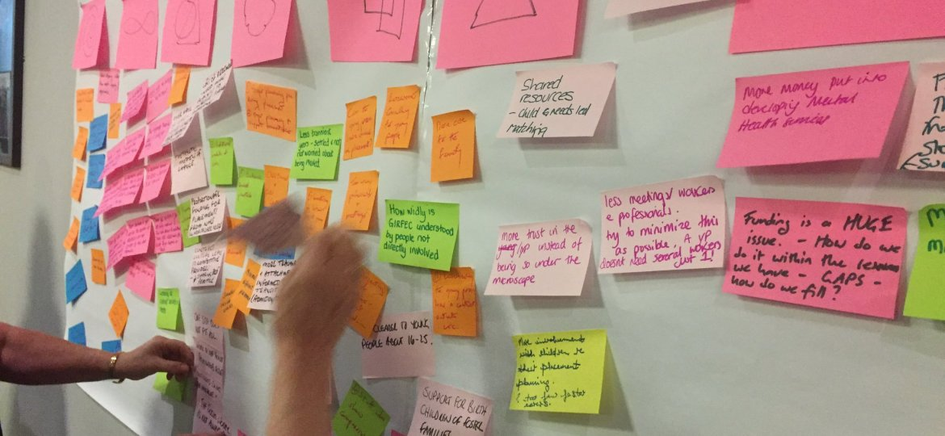
Notes:
Now we’ll start the process of debating the flow and arranging these ideas into a coherent ToC. We won’t finish this today so will regroup at a later date to continue. Our aim for this session is to land on ……
So, back into groups for 10 mins but this time looking at the other group’s boards. Think about:
How did you find that process? Any boards that felt particularly challenging or came easily?
What stands out/resonates? Drawn to?
Is there anything missing? Or out of place?
Would this work for all of your activities? Are there exceptions?
Tips for refining and putting into a diagram
Unpick individual post-its - try not to have more than one outcome or mechanism together
Put things into buckets (e.g. group by activity)
Think about your accountability line - can X really be something you are accountable for?
Think about measurement - how could you measure that?
Bringing in other stakeholders, before (with post-its) or with a draft diagram?
MoC or outcome? Switch to outcome if it feels like more of an aspiration rather than something that is actually happening right now
Need to ensure that causal link between MoC and outcomes
Accountability lines can sit anywhere, depending on relationships and evidence - what is the link between the outcome and the aim? E.g. level 2 qualifications demonstrated to make young people more likely to be employed
Start to plant evaluation planning seeds (e.g. ‘you could ask this via feedback forms’)
30 minutes

Slide 40
Theory of change templates
These are common formats to present your theory of change. Choose the one that works best for your work.

Slide 41
Organisation and programme/project title
Aim
Outcomes
Mechanisms of Change
Activities

Slide 42
Organisation & Programme/ Project Title
Activities
Mechanisms of Change
Intermediate outcomes
Long-term outcomes
Aim

Slide 43
Organisation and programme/project title
Activities
Mechanisms of Change
Outcomes
Aim

Slide 44
Drawing an ‘accountability line’
If your theory of change sets out outcomes and aims for young people that are beyond your direct sphere of influence, or that you expect to develop after they have finished attending your provision, it can useful to draw an accountability line.
Your accountability line may sit:
Between intermediate and long term outcomes
Outcomes and your overall aim

Slide 45
Next steps
Notes:
Review what we’ve achieved today
Review next steps (suggestions below)
smaller team will formalise all the thinking into a ToC diagram (all should fit onto one side of A4
hold discussions with others to consult on this ToC - with those that weren’t involve
What does a formal approval look like in your organisation?
‘Finalising’ the ToC - taking into account the consultation discussions, build a final version for review by decision makers / approvers
Then you’ll need to think about…:
communicating the ToC around the organisation and with stakeholders
Continuing to review and refine

Slide 46
EXAMPLE FOR REFERENCE
Theory of Change for Open Access Youth Provision
- developed as part of the Youth Investment Fund.

Slide 47
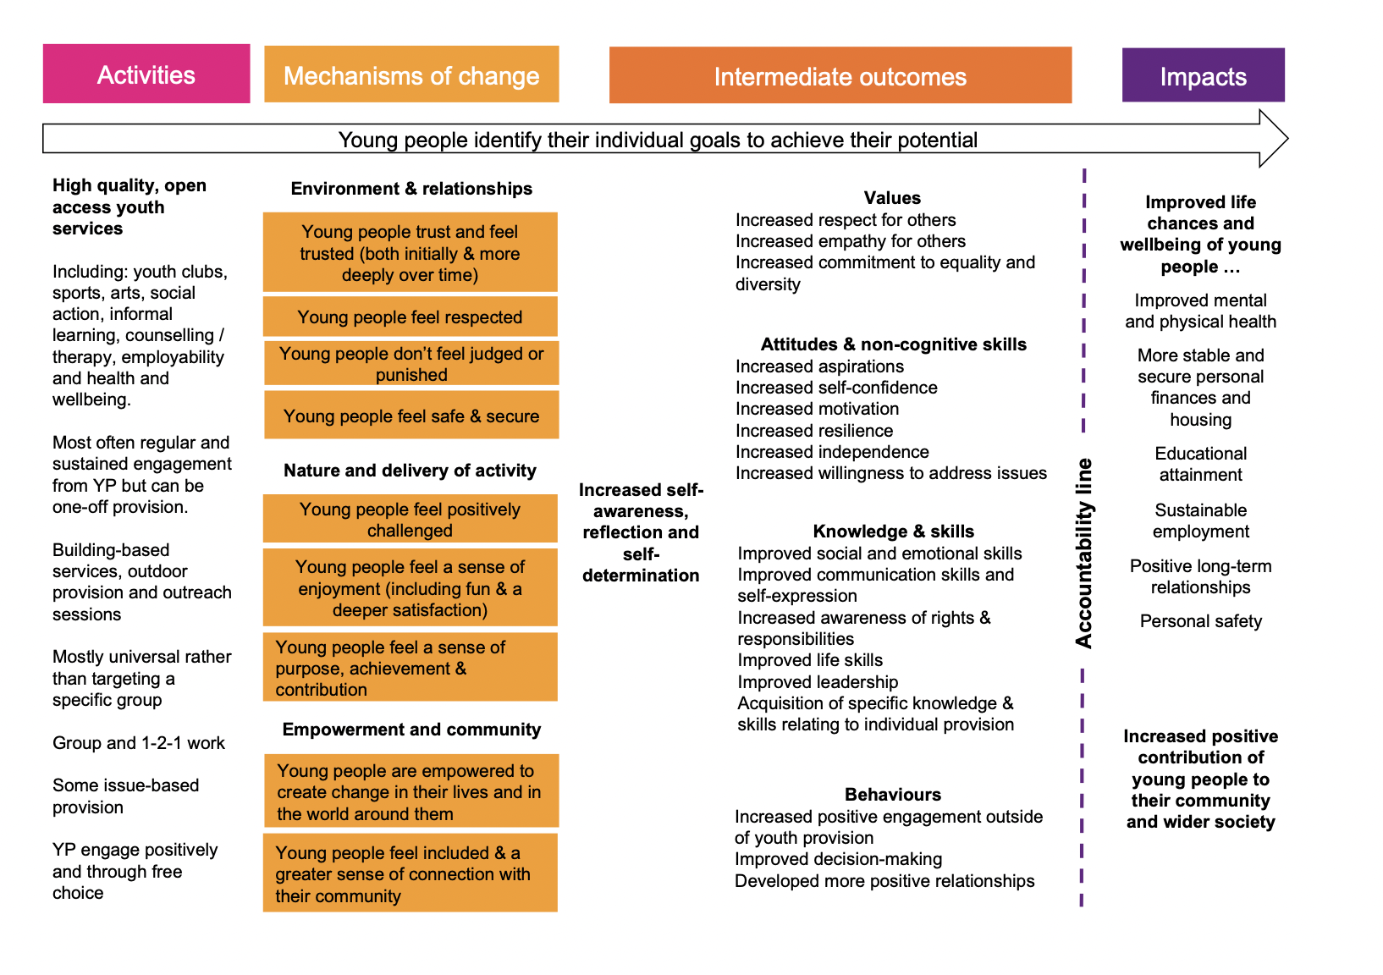
The Youth Investment Fund Theory of Change for open access youth provision.

